Slide 1

REU Project Proposal:
Using Genetic Algorithms to Generate Optimal Positioning for Drone Base Stations in a Temporary Network
Nicholas Ceccarelli
June 13, 2019

Slide 2
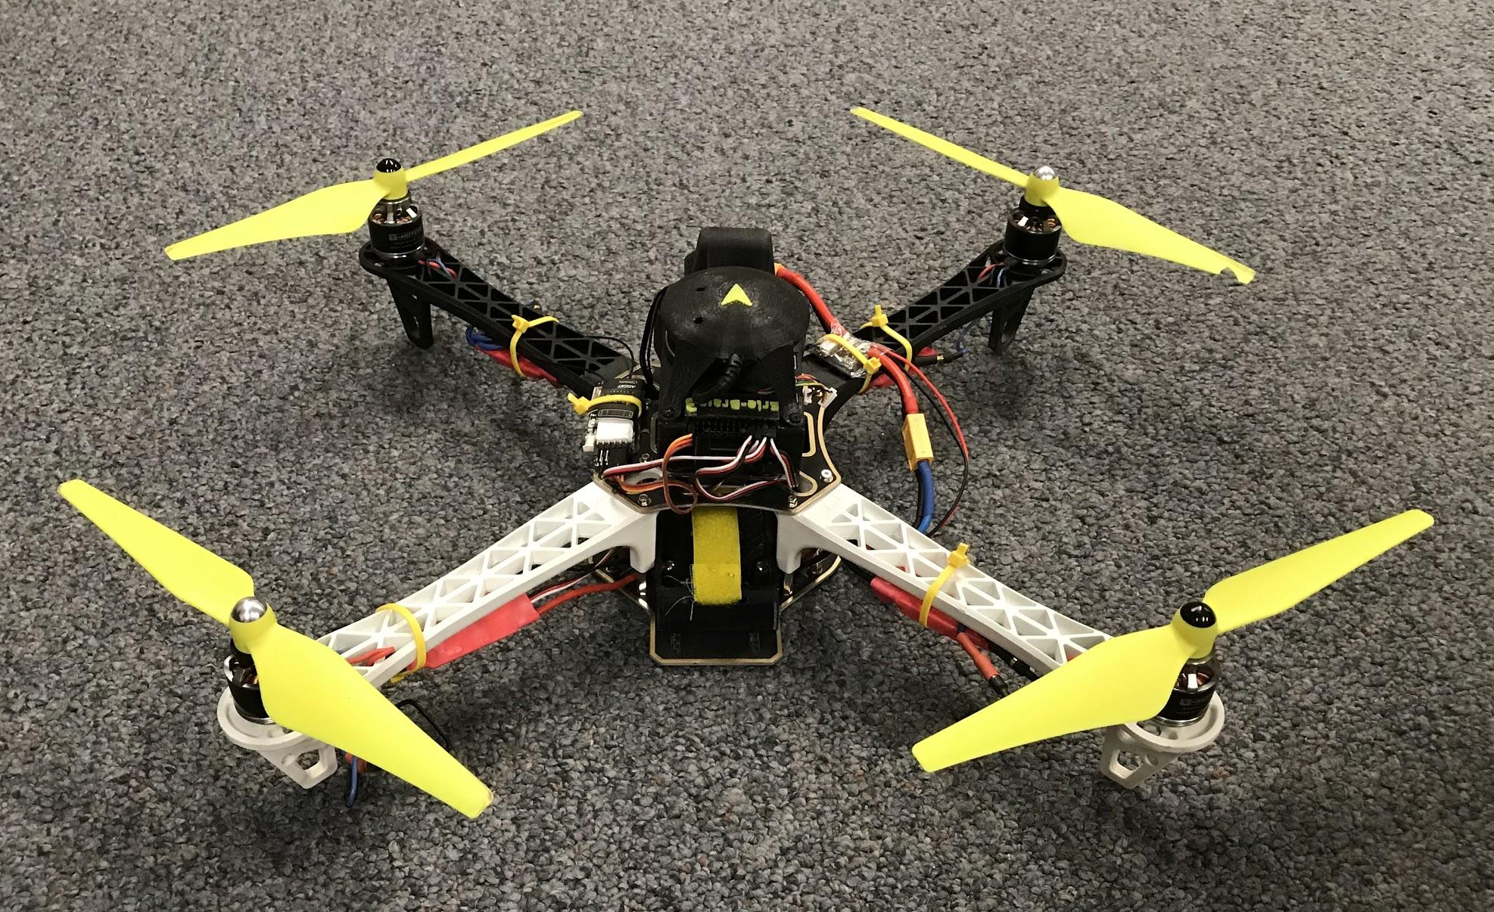
Project Context
Drone (UAV) swarm application: search-and-rescue communication
A way for first responders to communicate in remote areas
Create a temporary network with radio-equipped UAVs
Efficiency in positioning will allow for more responders to have coverage
Notes:
Many different uses for UAVs: from pure enjoyment, video recording, and even to military usages
Many UAVs working cohesively, aka a swarm, could assist in search and rescue missions
means of communication for those searching
particularly in remote areas with little previously existing communication infrastructure
For example, if someone fell while hiking in Alaska, this system could assist those searching for this person in finding
Calculated positioning of the UAVs allows for more efficient coverage of users and could both keep costs lower and allow network coverage for more first-responders

Slide 3
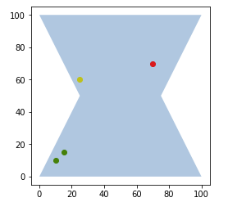
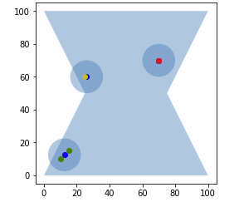
Goal
Create a system that can take as input:
A density map of users in an area
A minimum percentage of users the network must cover
Network antenna specifications
And can output:
The minimum number of UAVs needed to provide coverage to an area
Locations and visualization for optimal UAV placement

Slide 4
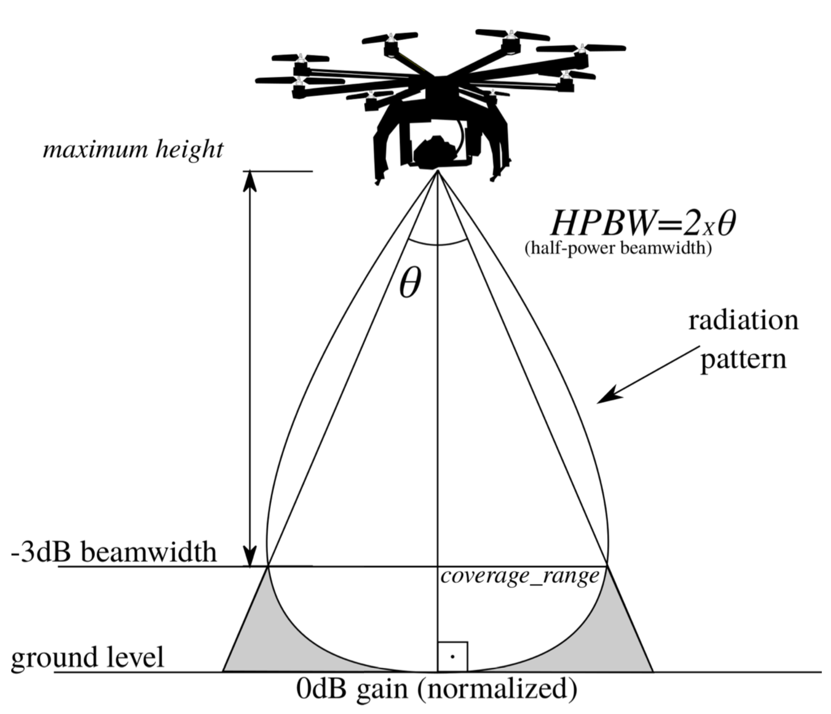
Approach
Calculate the coverage radius of the UAV
Past Networking Lab work
Friis Transmission Equation
Determine the minimum number of UAVs
Genetic Algorithm
Display an example of coverage
Genetic Algorithm
Visualization

Slide 5
Success Criteria
Simulations will be run to gather data regarding the effectiveness of the solution
Results will be compared to other work to ensure efficiency
Project Milestones:
Visualization script
Derive a formula and example for calculating coverage radius
Write genetic algorithm for generating UAV locations
Write genetic algorithm for deriving minimum number of UAVs in the swarm
Verify performance by simulation and comparison to prior work
22

